Slide 1


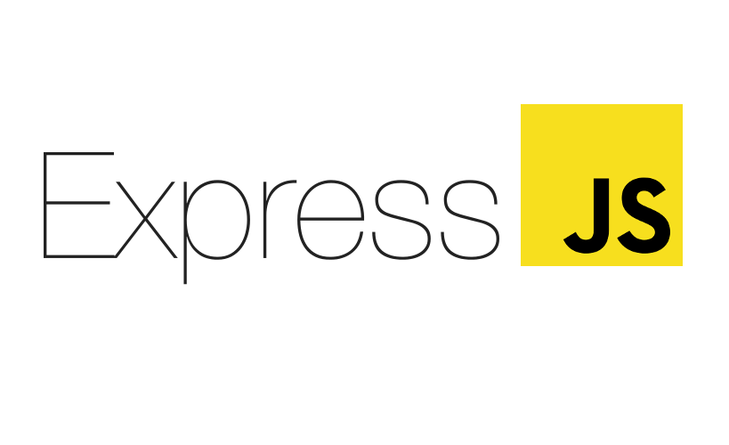
Backend JS

Slide 2
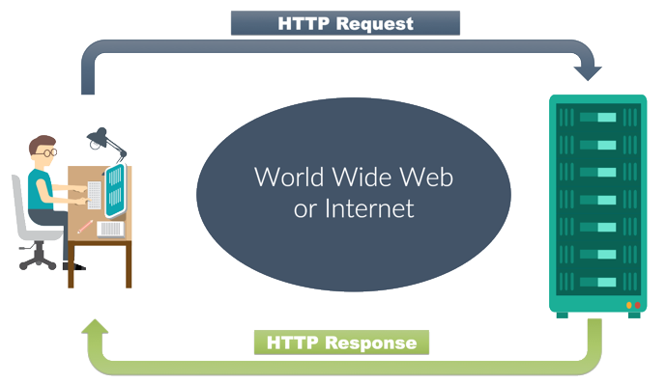
How Internet Work ?
REQUEST
RESPONSE
URL QUERY

Slide 3
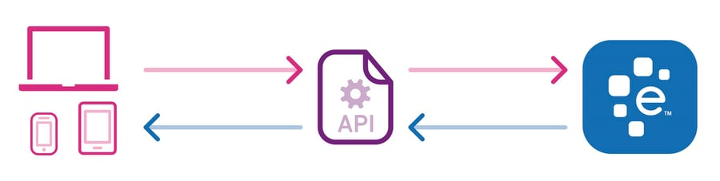
WHAT IS API ?
The user initiates an API call that tells the application to do something, then the application will use an API to ask the web server to do something.
POSTMAN - Postman is an API platform for developers to design, build, test and iterate their APIs.

Slide 4
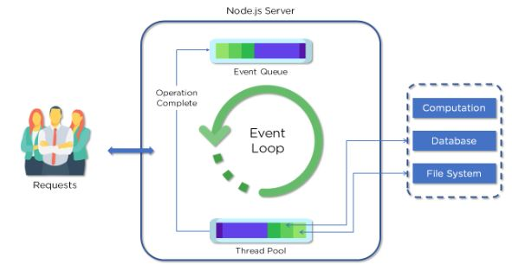
NodeJS Architecture
Requests
Node.js Server
Event Queue
Thread Pool
Event Loop
External Resource

Slide 5
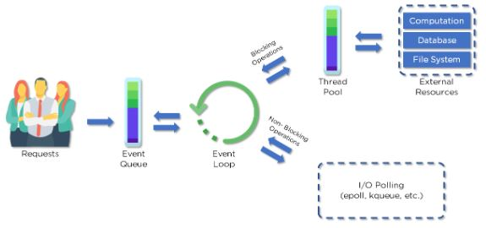
Workflow of Nodejs Architecture
Querying for Data
Deleting Data
Updating Data

Slide 6
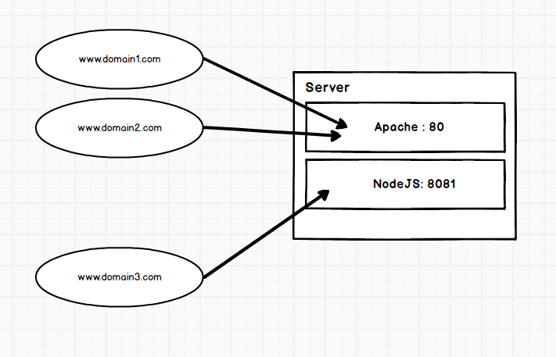
Server
Listen
Local Host (Domain)
PORT

Slide 7
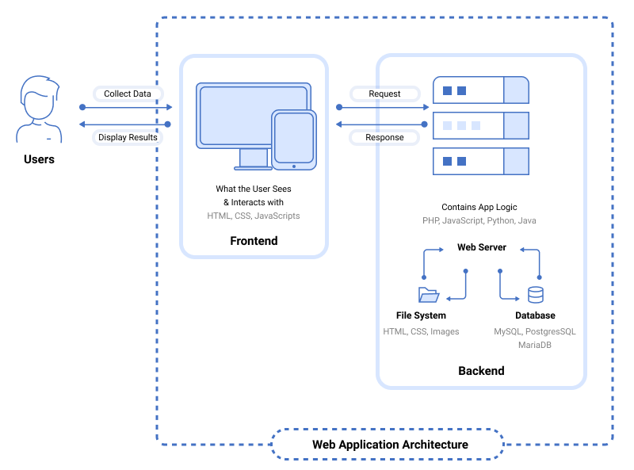
Application Workflow

Slide 8
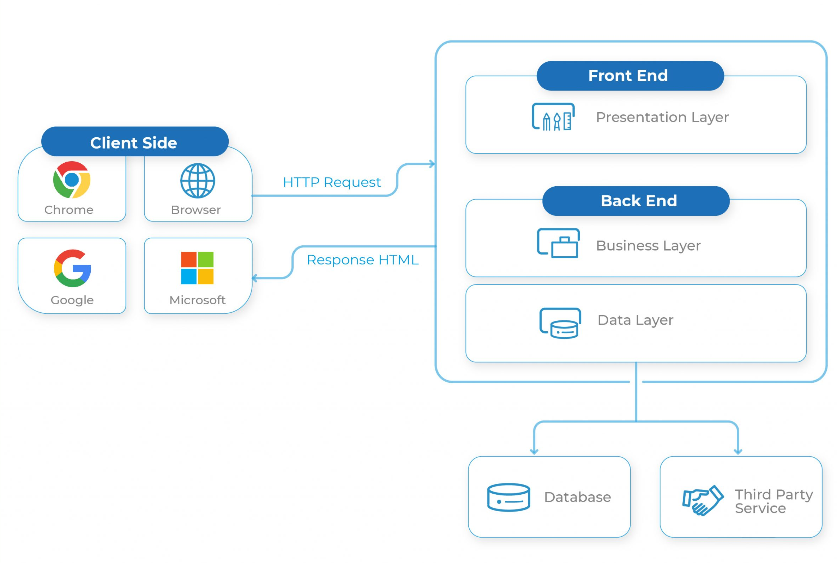

Slide 9


DATABASE
NoSQL
SQL

Slide 10
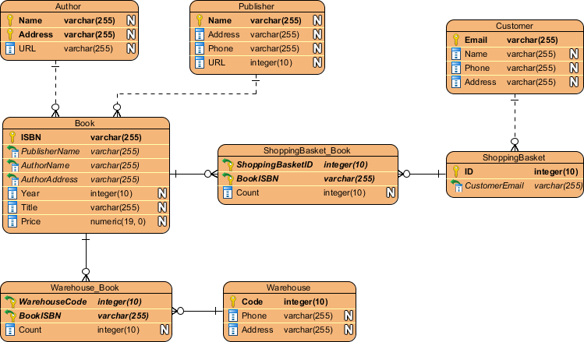
Relational and Non – Relational Database

Slide 11
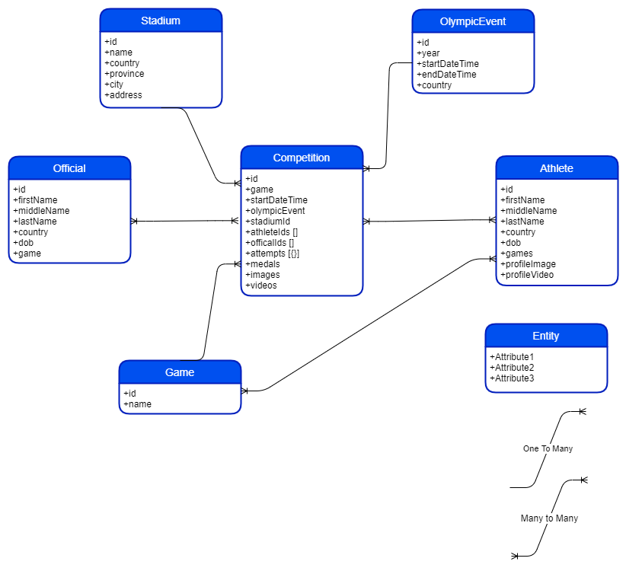
Relational and Non – Relational Database

Slide 12
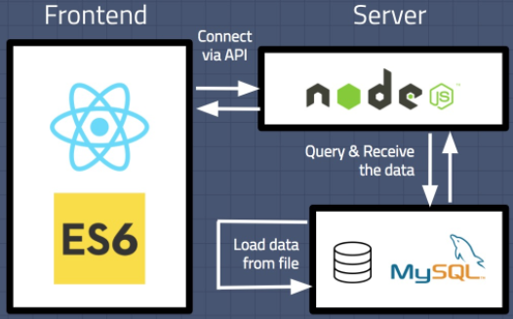
Database Connection

Slide 13

MVC Architecture

Slide 14
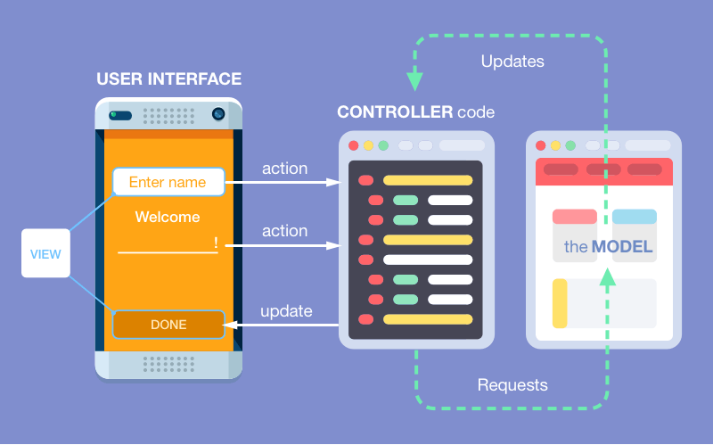
Model, View and Controllers

Slide 15
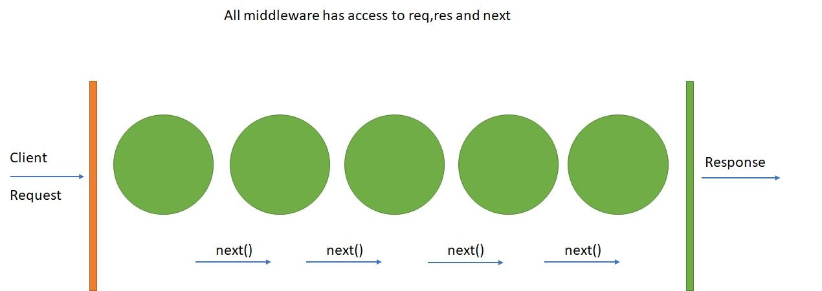
Middleware

Slide 16
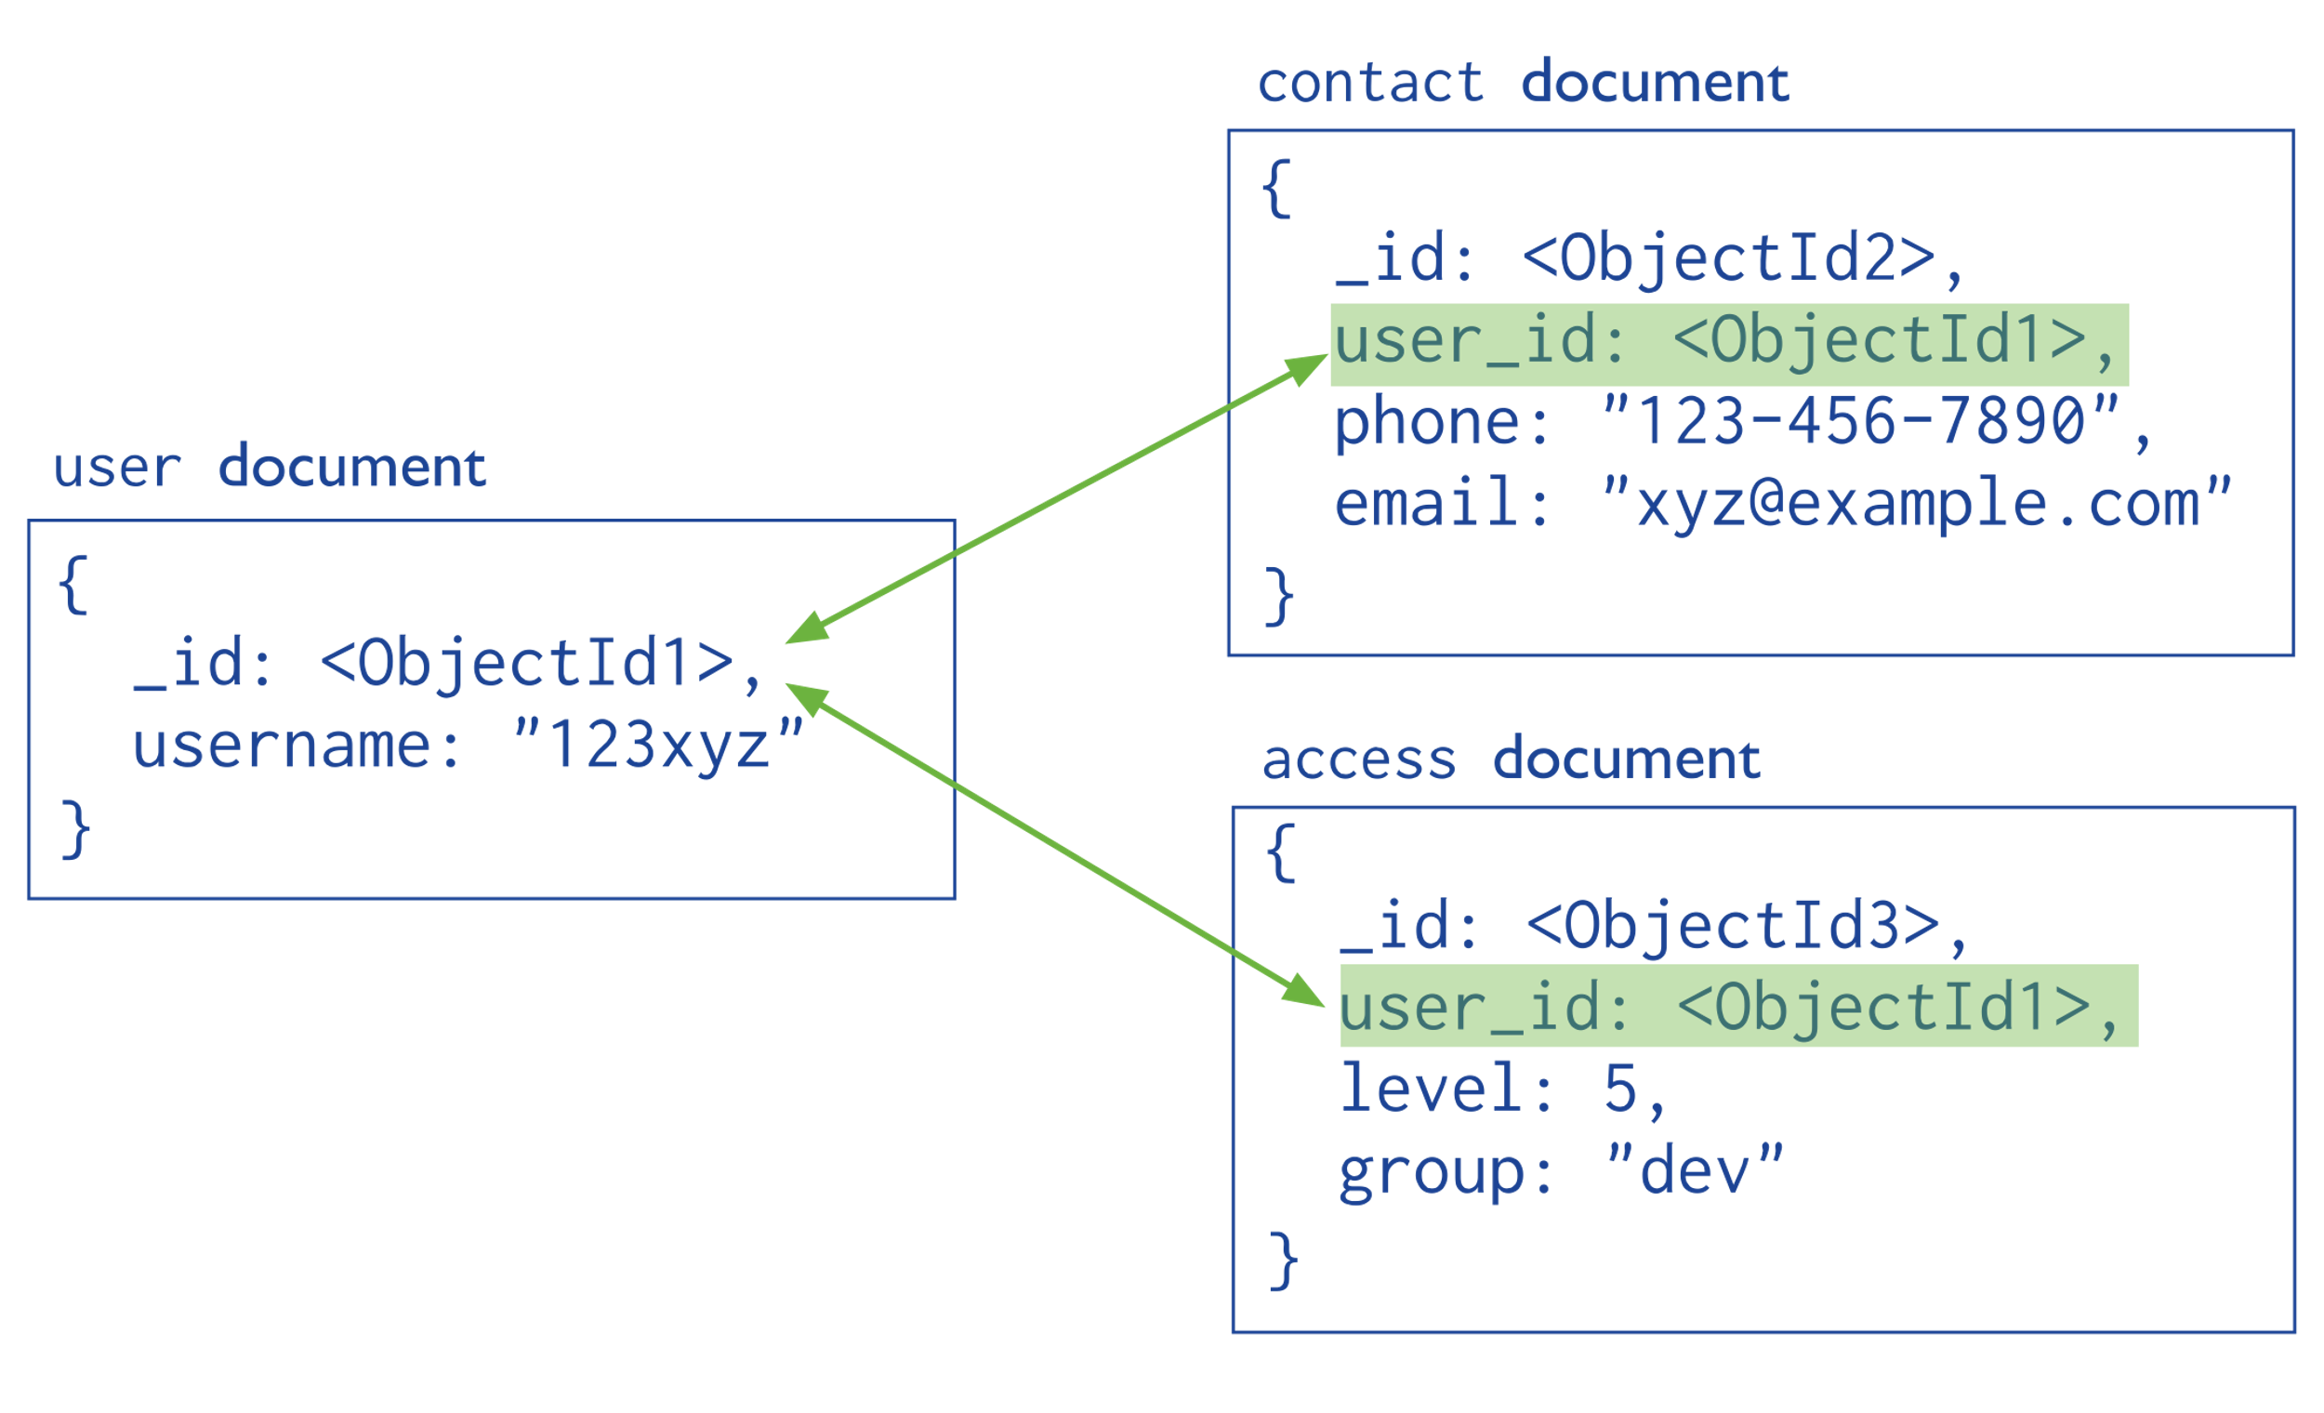
Models

Slide 17
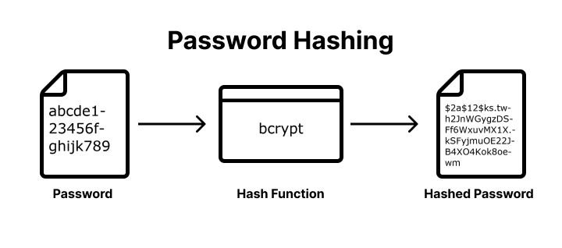
Password Hashing

Slide 18
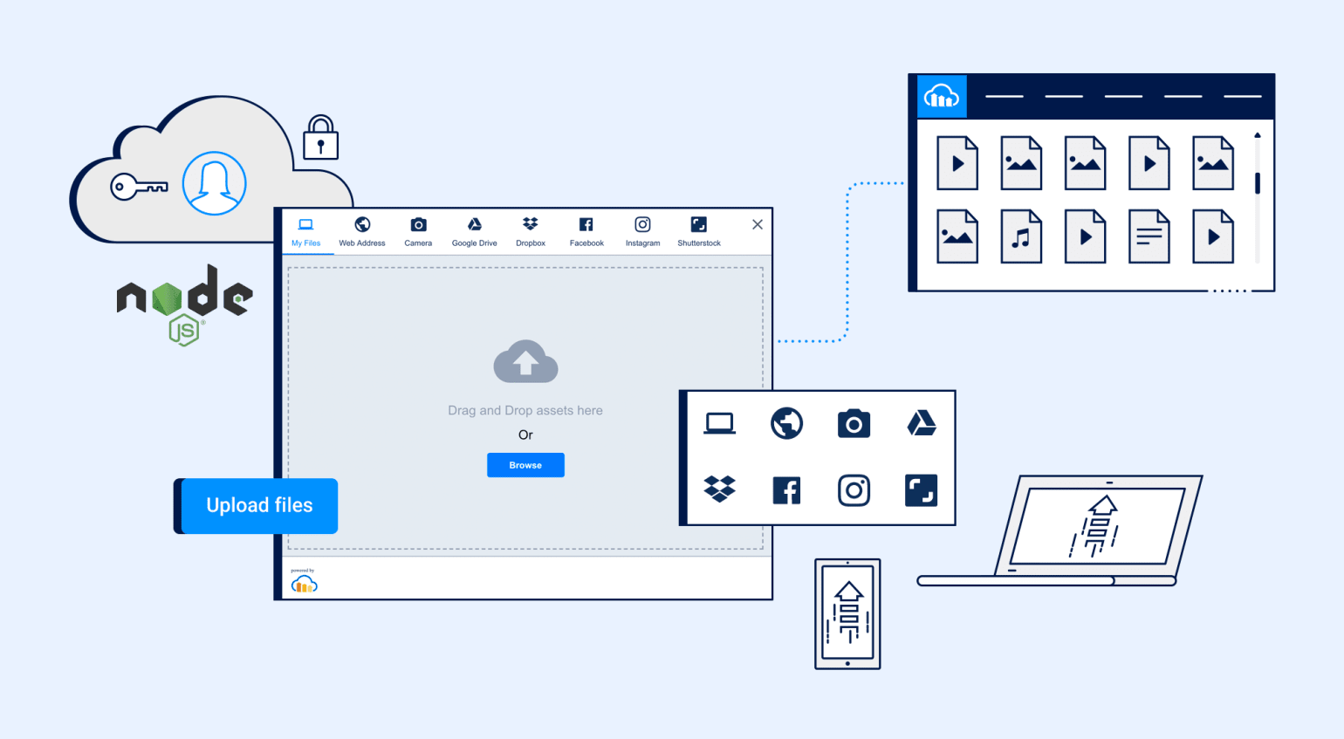
Storing Media

